Slide 1
Week 6 Pointers part 1
CS 331
An introduction to C++ and Object-Oriented Programming
MD Romael Haque

Slide 2
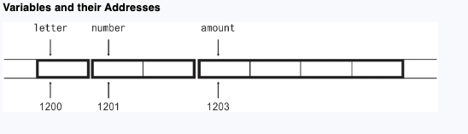
Pointers and the Address Operator
Every variable is assigned a memory location whose address can be retrieved using the address operator &.
The address of a memory location is called a pointer.
Each byte of memory has a unique address. A variable’s address is the address of the first byte allocated to that variable.

Slide 3
Pointers and the Address Operator
C++ has an address operator & that can be used to retrieve the address of any variable. - &amount
cout ≪ long(&amount);
By default, C++ prints addresses in hexadecimal.

Slide 4
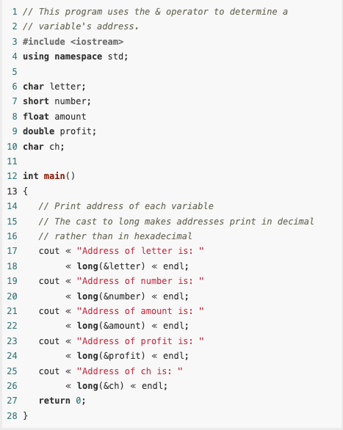
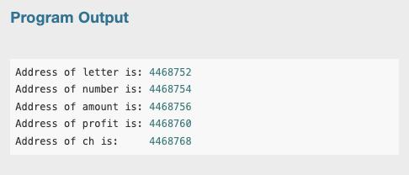
Example

Slide 5
Pointer Variables
Like other data values, memory addresses, or pointer values, can be stored in variables of the appropriate type.
A variable that stores an address is called a pointer variable, but is often simply referred to as just a pointer.
int *ptr;
The asterisk before the variable name indicates that ptr is a pointer variable, and the int data type indicates that ptr can only be used to point to, or hold addresses of, integer variables.

Slide 6
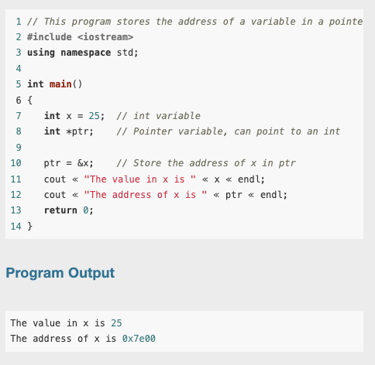
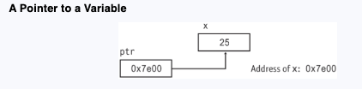
Example

Slide 7
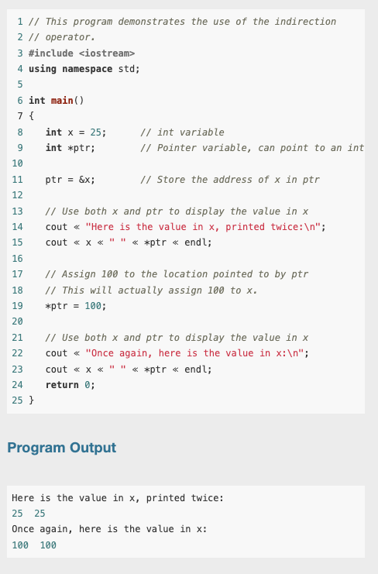
Example
You can use a pointer to indirectly access and modify the variable being pointed to.

Slide 8
The Relationship Between Arrays and Pointers
You learned earlier that an array name, without brackets and a subscript, actually represents the starting address of the array.
This means that an array name is really a pointer
So, Array names can be used as pointer constants, and pointers can be used as array names.

Slide 9
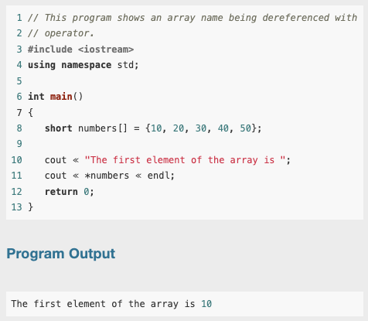
Example
Because numbers works like a pointer to the starting address of the array in.
In this program, the first element is retrieved when numbers is dereferenced.
So, how could the entire contents of an array be retrieved using the indirection operator?

Slide 10

The Relationship Between Arrays and Pointers
Remember, array elements are stored together in memory
It makes sense that if numbers is the address of numbers[0], values could be added to numbers to get the addresses of the other elements in the array.
It’s important to know, however, that pointers do not work like regular variables when used in mathematical statements.

Slide 11

The Relationship Between Arrays and Pointers
In C++, when you add a value to a pointer, you are actually adding that value times the size of the data type being referenced by the pointer.
In other words, if you add one to numbers, you are actually adding 1 * sizeof(short) to numbers. If you add two to numbers, the result is numbers + 2 * sizeof(short), and so forth.

Slide 12
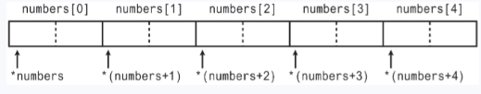
The Relationship Between Arrays and Pointers
This automatic conversion means that an element in an array can be retrieved by using its subscript or by adding its subscript to a pointer to the array.
If the expression *numbers, which is the same as *(numbers + 0), retrieves the first element in the array,
Then *(numbers + 1) retrieves the second element. Likewise, *(numbers + 2) retrieves the third element, and so forth.

Slide 13
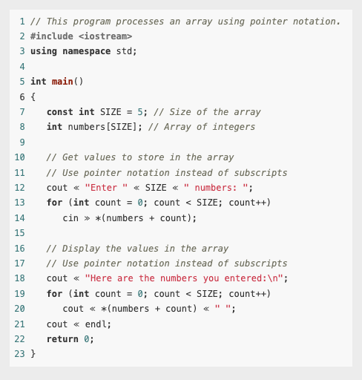
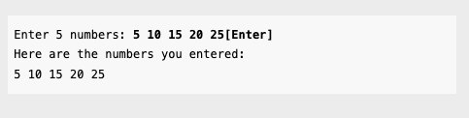
Example
array[index] is equivalent to *(array + index)

Slide 14
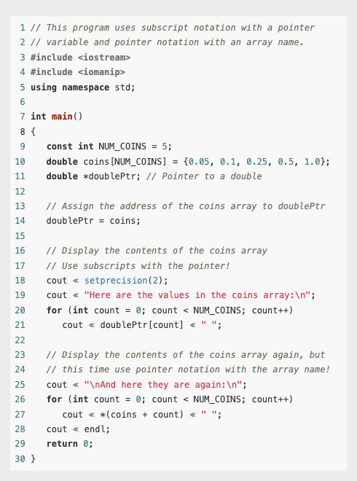
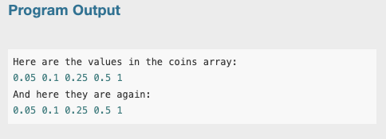
Example

Slide 15
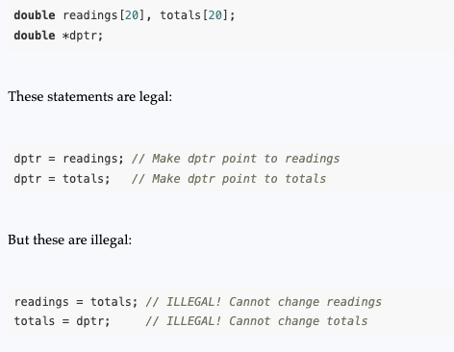
The Relationship Between Arrays and Pointers
The only difference between array names and pointer variables is that you cannot change the address an array name points to. For example, given the following definitions:
Array names are pointer constants. You can’t make them point to anything but the array they represent.

Slide 16
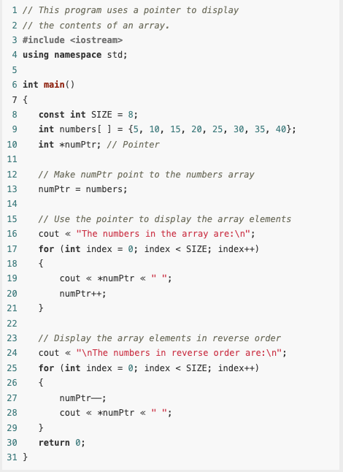
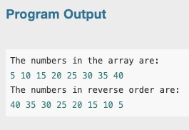
Pointer Arithmetic
The contents of pointer variables may be changed with mathematical statements that perform addition or subtraction
Because numPtr is a pointer, the increment operator adds the size of one integer to numPtr, so it points to the next element in the array. Likewise, the decrement operator subtracts the size of one integer from the pointer.

Slide 17
Pointer Arithmetic
Not all arithmetic operations may be performed on pointers.
For example, you cannot use multipication or division with pointers. The following operations are allowable:
The ++ and –– operators may be used to increment or decrement a pointer variable.
An integer may be added to or subtracted from a pointer variable. This may be performed with the + and – operators, or the += and −= operators.
A pointer may be subtracted from another pointer.

Slide 18



Initializing Pointers
Pointers may be initialized with the address of an existing object.
Remember that a pointer is designed to point to an object of a specific data type.
When a pointer is initialized with an address, it must be the address of an object the pointer can point to.
Legal
Legal
Illegal

Slide 19

Initializing Pointers
Pointers may be defined in the same statement as other variables of the same type.
int myValue, *pint = &myValue;
double readings[50], *marker = readings;
A pointer can only be initialized with the address of an object that has already been defined. The following is illegal

Slide 20

Initializing Pointers
A local pointer variable that has not been initialized does not hold a valid address, and an attempt to use such a pointer will result in execution-time errors.
The convention in older versions of C++ is to assign the address 0 to a pointer that does not currently point to a valid memory location:
In many computers, the address 0 is occupied by operating system data and is not accessible to user programs. This makes 0 a safe choice for a value that indicates an invalid memory location.

Slide 21


Initializing Pointers
Many header files, including iostream, fstream, and cstdlib, define a constant named NULL to represent the pointer value 0
A pointer whose value is 0 is called a null pointer. C++ 11 defines the key word nullptr to indicate an invalid memory address:

Slide 22

Initializing Pointers
You can test a pointer p against 0, NULL, or nullptr to determine if it points to a valid address using equality-testing operators != and ==. For example,

Slide 23
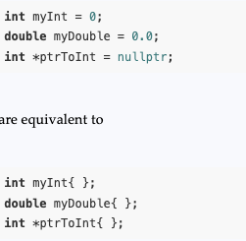
Initializing Pointers
In C++ 11, putting an empty pair of braces { } at the end of a variable definition initializes the variable to its default value. The default value for numeric types such as int, long, and double is zero, while the default value for pointer types is nullptr.

Slide 24
Comparing Pointers
C++’s relational operators may be used to compare pointer values. > < == != >= <=
If one address comes before another address in memory, the first address is considered “less than” the second.
In an array, all the elements are stored in consecutive memory locations, so the address of element 1 is greater than the address of element 0.

Slide 25
Comparing pointers
Because the addresses grow larger for each subsequent element in the array, the following Boolean expressions are all true:
&array[1] > &array[0]
array < &array[4]
array == &array[0]
&array[2] != &array[3]

Slide 26
Comparing pointers
Comparing two pointers is not the same as comparing the values the two pointers point to. For example, the following if statement compares the addresses stored in the pointer variables ptr1 and ptr2:
if (ptr1 < ptr2)
The following statement, however, compares the values that ptr1 and ptr2 point to:
if (*ptr1 < *ptr2)
The capability of comparing addresses gives you another way to be sure a pointer does not go beyond the boundaries of an array.

Slide 27
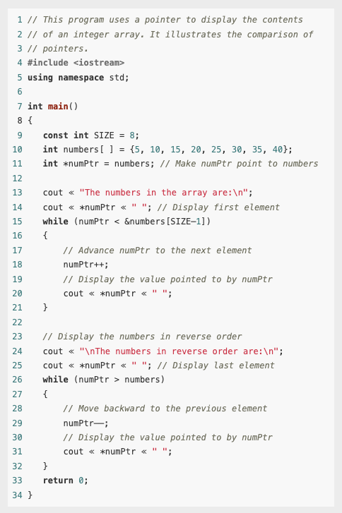
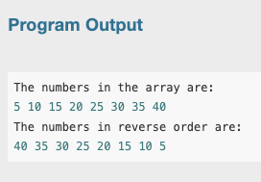
Example

Slide 28
Comparing pointers
Most comparisons involving pointers compare a pointer to 0, NULL, or nullptr to determine whether the pointer points to a legitimate address. For example, assuming that ptrToInt has been defined as a pointer to int, the code prints the integer pointed to only after verifying that ptrToInt is not a null pointer.
if (ptrToInt != nullptr)
cout ≪ *ptrToInt;
else
cout ≪ "null pointer";

Slide 29
Pointers as Function Parameters
A pointer can be used as a function parameter. It gives the function access to the original argument, much like a reference parameter does.
A reference variable acts as an alias to the original variable used as an argument.
This gives the function access to the original argument variable, allowing it to change the variable’s contents.
When a variable is passed into a reference parameter, the argument is said to be passed by reference.
An alternative to passing an argument by reference is to use a pointer variable as the parameter.

Slide 30
Pointers as Function Parameters
Admittedly, reference variables are much easier to work with than pointers. Reference variables hide all the “mechanics” of dereferencing and indirection.
You should still learn to use pointers as function arguments, however, because some tasks requires it.
Also, the C++ library has many functions that use pointers as parameters.

Slide 31

Pointers as Function Parameters
This statement multiplies the original variable, whose address is stored in val, by two.
When the function is called, the address of the variable that is to be doubled must be used as the argument, not the variable itself. such as doubleValue(&number);

Slide 32
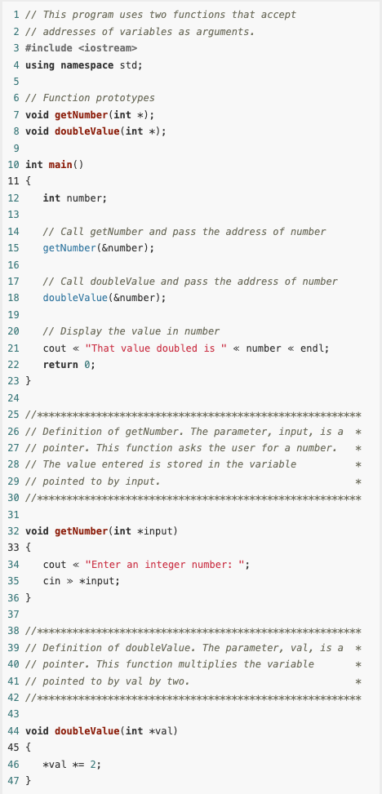
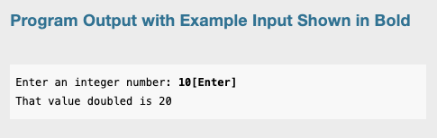
Example
It’s critical that the indirection operator be used in the (cin >> *input) statement.
Without it, cin would store the value entered by the user in input, as if the value were an address.
If this happens, input will no longer point to the number variable in function main. Subsequent use of the pointer will result in erroneous, if not disastrous, results.

Slide 33
Pointers to Constants and Constant Pointers
A pointer to a constant may not be used to change the value it points to;
A constant pointer may not be changed after it has been initialized.

Slide 34
Pointers to Constants
You have seen how an item’s address can be passed into a pointer parameter, and the pointer can be used to modify the item that was passed as an argument.
Sometimes it is necessary to pass the address of a const item into a pointer. When this is the case, the pointer must be defined as a pointer to a const item.

Slide 35

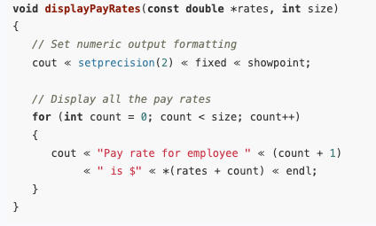
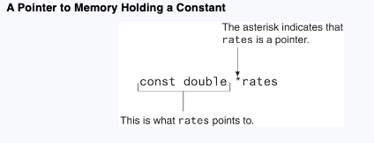
Example
In this code, payRates is an array of const doubles.
This means that each element in the array is a const double, and the compiler will not allow us to write code that changes the array’s contents.
If we want to pass the payRates array into a pointer parameter, the parameter must be declared as a pointer to const double.
In the function header, notice that the rates parameter is defined as a pointer to const double. It should be noted that the word const is applied to the thing that rates points to, not rates itself.
Because rates is a pointer to a const, the compiler will not allow us to write code that changes the thing that rates points to.
Because rates is a pointer to a const, the compiler will not allow us to write code that changes the thing that rates points to.

Slide 36
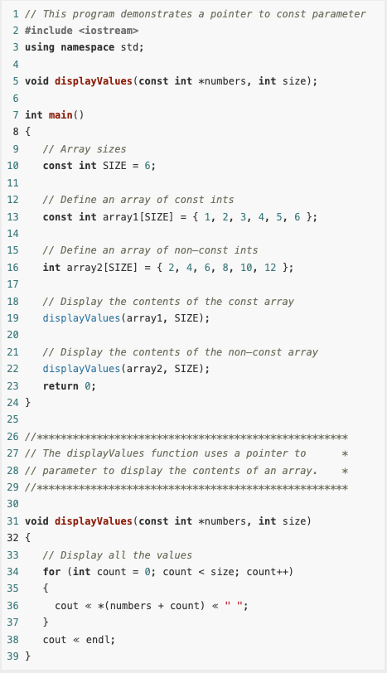
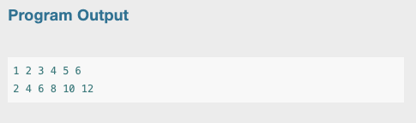
Passing a Non-Constant Argument into a Pointer to a Constant
Although a constant’s address can be passed only to a pointer to const, a pointer to const can also receive the address of a non-constant item.
When writing a function that uses a pointer parameter, and the function is not intended to change the data the parameter points to, it is always a good idea to make the parameter a pointer to const.
Not only will this protect you from writing code in the function that accidentally changes the argument, but the function will be able to accept the addresses of both constant and non-constant arguments.

Slide 37
Constant Pointers
We discussed pointers to const, that is, pointers that point to const data. You can also use the const key word to define a constant pointer. Here is the difference between a pointer to const and a const pointer:
A pointer to const points to a constant item. The data that the pointer points to cannot change, but the pointer itself can change.
With a const pointer, it is the pointer itself that is constant. Once the pointer is initialized with an address, it cannot point to anything else.

Slide 38
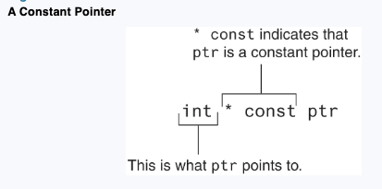

Constant Pointers
In the code, ptr is initialized with the address of the value variable. Because ptr is a constant pointer, a compiler error will result if we write code that makes ptr point to anything else. An error will not result, however, if we use ptr to change the contents of value. This is because value is not constant, and ptr is not a pointer to const.

Slide 39
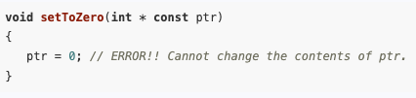
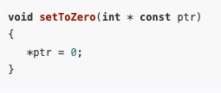
Constant Pointers
Constant pointers must be initialized with a starting value, as shown in the previous example code.
If a constant pointer is used as a function parameter, the parameter will be initialized with the address that is passed as an argument into it and cannot be changed to point to anything else while the function is executing.
However, ptr does not point to a const, so we can have code that changes the data that ptr points to.

Slide 40
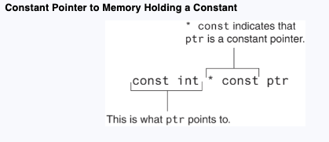

Constant Pointers to Constants
So far, when using const with pointers we’ve seen pointers to constants and we’ve seen constant pointers.
We can also have constant pointers to constants.
In the code, ptr is initialized with the address of value. Because ptr is a const pointer, we cannot write code that makes ptr point to anything else. Because ptr is a pointer to const, we cannot use it to change the contents of value.

